Slide 1
SECURE Data HIDING IN IMAGES USING STEGANOGRAPHY
CAPSTONE PROJECT
Presented By: Aman Kumar
Student Name : Aman Kumar
College Name & Department : H.D Jain College, BCA Department

Slide 2
OUTLINE
Problem Statement -------------------------------------------------------------------------------------------- 1
Technology used ----------------------------------------------------------------------------------------------- 2
Wow factor -------------------------------------------------------------------------------------------------------- 3
End users --------------------------------------------------------------------------------------------------------- 4
Result --------------------------------------------------------------------------------------------------------------- 5
Conclusion ------------------------------------------------------------------------------------------------------- 6
GitHub Link ------------------------------------------------------------------------------------------------------ 7
Future scope ----------------------------------------------------------------------------------------------------- 8

Slide 3
Problem Statement
Digital communication faces increasing security threats, with sensitive information vulnerable to interception during transmission. Traditional encryption methods often draw attention to the existence of secret data. This project addresses the need for covert information exchange by implementing steganography techniques to hide confidential messages within seemingly ordinary image files, providing an additional layer of security through obscurity alongside password protection.

Slide 4
Technology used
Python: Core programming language OpenCV (CV2): For image processing and manipulation OS Module: For system-level operations String Module: For character manipulation Steganography Algorithm: Custom implementation that embeds message characters into pixel values Password-based Authentication: Ensures only authorized users can access hidden messages
Bootstrap (Frontend design) HTML5/CSS3(UI components) Werkzeug

Slide 5
Wow factors
The project’s impressive aspect is its subtlety – it creates images that appear visually identical to the original while secretly containing embedded information. The system distributes message data across all three RGB color channels in a diagonal pattern, making detection through visual inspection nearly impossible. Additionally, the password protection prevents unauthorized extraction of the hidden message, creating a dual-layer security approach that combines the concepts of “hiding in plain sight” with traditional authentication.

Slide 6
End users
This steganography solution benefits:
Individuals concerned with privacy who need to share sensitive information
Journalists working in restrictive environments Corporate professionals exchanging confidential business data Government agencies requiring secure communications channels Cybersecurity professionals implementing multi-layered security solutions Educational institutions teaching concepts of information security

Slide 7
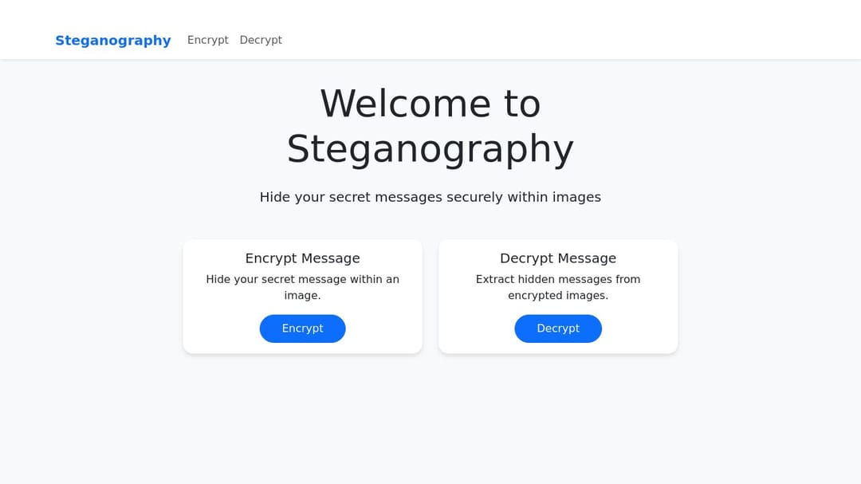
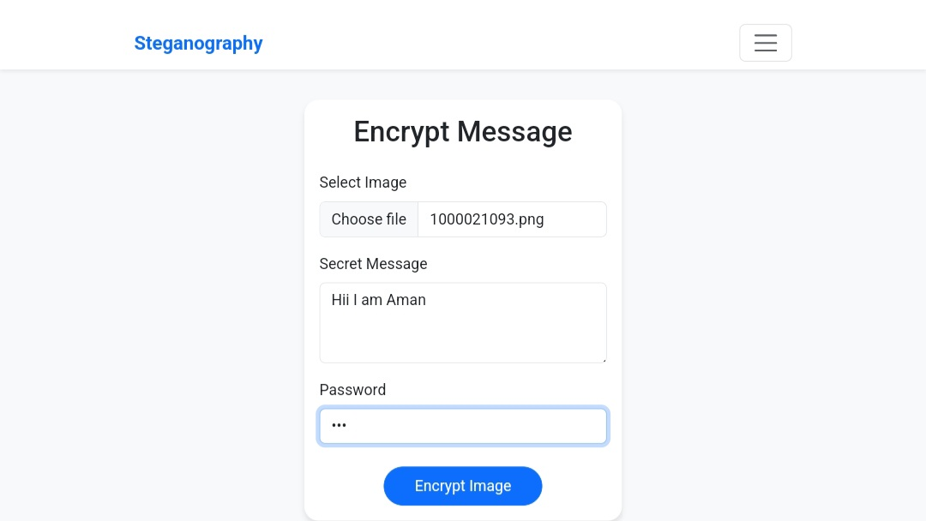
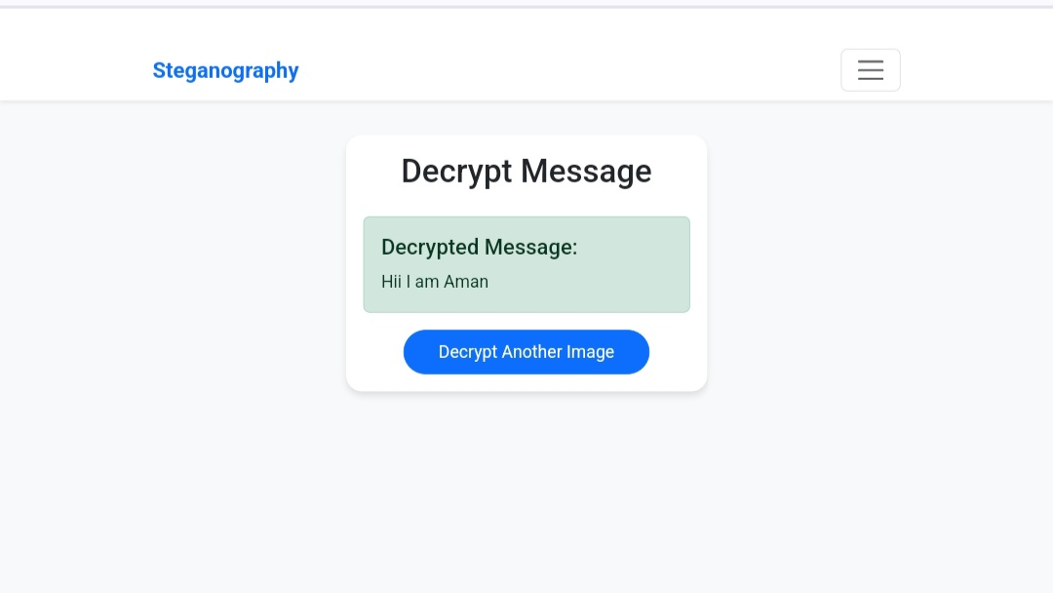
Results

Slide 8
Conclusion
This project demonstrates that steganography offers a viable approach to information security by concealing the very existence of sensitive data. By embedding messages within ordinary image files and implementing password protection, the solution provides both security through obscurity and authentication. The diagonal pattern and RGB channel rotation technique enhances the difficulty of detecting the presence of hidden information, while the simple user interface makes the technology accessible to non-technical users.

Slide 9
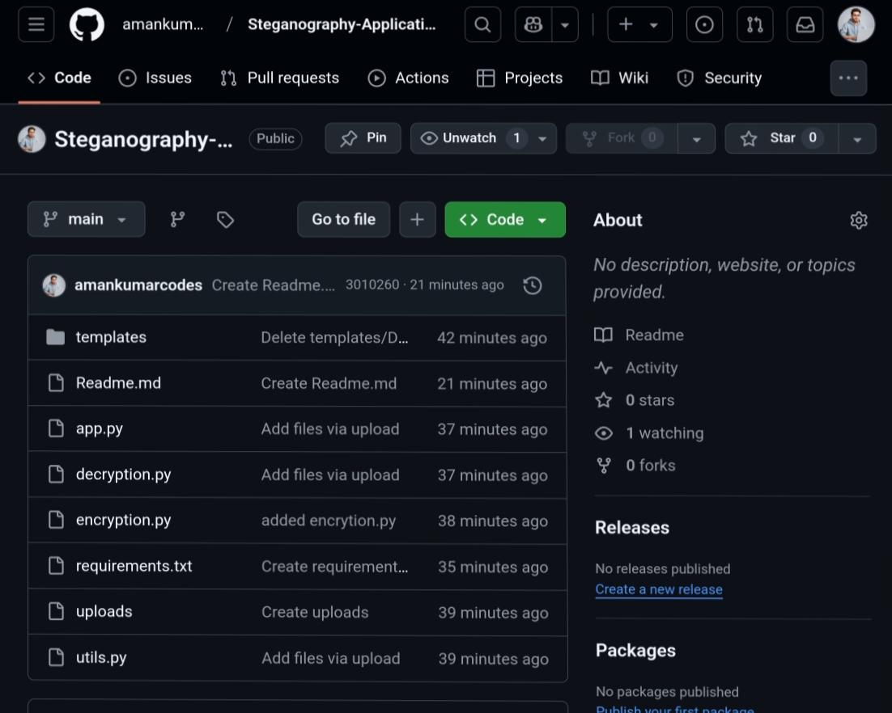
GitHub Link
https://github.com/amankumarcodes/Steganography-Application

Slide 10
Future scope
The project can be expanded in several directions:
Enhanced Capacity: Implementing more efficient encoding to store larger messages Multiple Media Support: Extending the algorithm to work with video and audio files Advanced Encryption: Incorporating AES or other encryption algorithms before embedding Error Correction: Adding redundancy to protect against image compression or manipulation Machine Learning Detection Resistance: Evolving the algorithm to resist statistical analysis and AI-based steganalysis GUI Interface: Developing a user-friendly graphical interface Web/Mobile Implementation: Creating a cross-platform application for wider accessibility Blockchain Integration: Using blockchain technology to verify the authenticity of steganographic images

Slide 11
THANK YOU

